Slide 1
Subgroup modeling

Slide 2
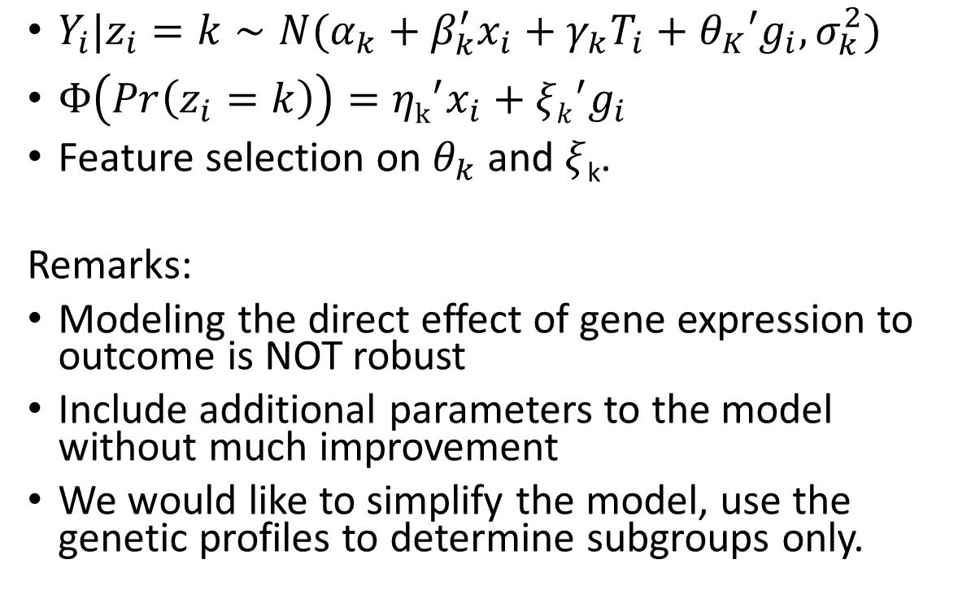
Old Model
Baseline variables
Gene expression
X
G
$Y_{i}|z_{i}=k∼N(α_{k}+β_{k}^{′}x_{i}+γ_{k}T_{i}+θ_{K}{′g}_{i}, σ_{k}^{2})$
$Φ\left(Pr\left(z_{i}=k\right)\right)={ηk}^{′}x_{i}+{ξk}^{′}g_{i}$
Feature selection on $θ_{k}$ and $ξ$_{k}.
Remarks:
Modeling the direct effect of gene expression to outcome is NOT robust
Include additional parameters to the model without much improvement
We would like to simplify the model, use the genetic profiles to determine subgroups only.
treatment
T
Z
Latent subgroup index
Y
outcome

Slide 3
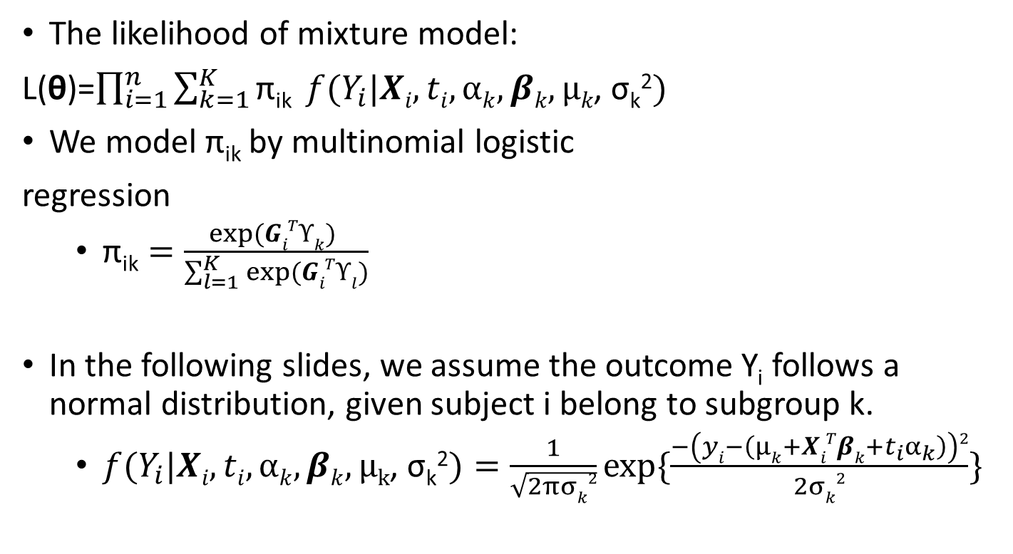
Model
Baseline variables
Gene expression
X
G
The likelihood of mixture model:
L(θ)=$\prod_{i=1}^{n}{\sum_{k=1}^{K}{\text{π}\text{ik}} {f(Y}_{i}|Xi, ti,αk,βk, μk\text{, }\text{σ}\text{k}\text{2}) }$
We model π_{ik} by multinomial logistic
regression
$\text{π}\text{ik}=\frac{exp⁡(GiTϒk) }{\sum_{l=1}^{K}{exp⁡(GiTϒl)}}$
In the following slides, we assume the outcome Y_{i} follows a normal distribution, given subject i belong to subgroup k.
${f(Y}_{i}|Xi, ti,αk,βk, μ\text{k}\text{, }\text{σ}\text{k}\text{2})=\frac{1}{\sqrt{2πσk2}}exp⁡\{\frac{−\left(yi−\left(μk+XiTβk+t_{i}α_{k}\right)\right)2}{2σk2}\}$
treatment
T
Z
Latent subgroup index
Y
outcome

Slide 4
EM algorithm
The complete log likelihood function can be written as:
Where

Slide 5
EM algorithm
E step
Where

Slide 6
EM algorithm
M step
ϒ_{k} is updated by solving
(Newton-Raphson algorithm)
μ_{k}, α_{k} are updated by the following updating equations

Slide 7
EM algorithm
β_{k}, σ_{k}² are updated by the following updating equations

Slide 8
A simple simulation scheme
n=500 subjects
Two subgroups K = 2
2 genes G = {G₁,G₂}
2 baseline clinical variables X={X₁,X₂}
Treatment Tϵ {0,1}
Set σ₁²=…=σ_{k}²= σ²

Slide 9
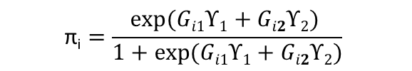
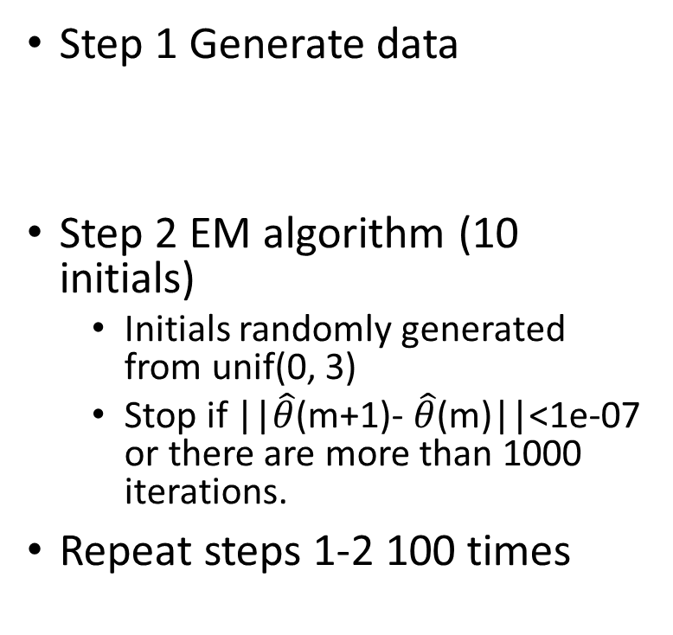
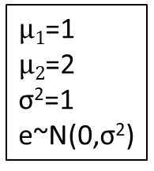

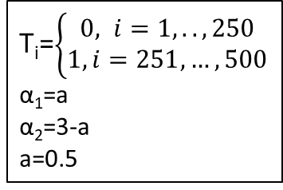
A simple simulation scheme
Baseline variables
Gene expression
Step 1 Generate data
Step 2 EM algorithm (10 initials)
Initials randomly generated from unif(0, 3)
Stop if ||$\hat{θ}$(m+1)- $\hat{θ}$(m)||<1e-07 or there are more than 1000 iterations.
Repeat steps 1-2 100 times
X1 ~ N(2,1)
X2 ~ N(4,2)
β1=1
β2=1
G1 ~ N(0,1)
G2 ~ N(0,1)
ϒ1=0.3
ϒ2=0.3
treatment
T_{i}=$\left\{\begin{aligned}0, i=1,..,250 \\ 1, i=251,…,500\end{aligned}\right.$
α₁=a
α₂=3-a
a=0.5
$$\text{π}\text{i}=\frac{exp⁡(Gi1ϒ1+Gi2ϒ2) }{1+exp⁡(Gi1ϒ1+Gi2ϒ2)}$$
Z_{i} ~ Bernoulli(π_{i})
Latent subgroup index
$μ1$=1
$μ2$=2
σ²=1
e~N(0,σ²)
$$yi=μk+Tiαk+XiTβk\text{+}\text{e}$$
outcome

Slide 10
Simulation result
Parameters | True | Estimated
α1 | 0.5
α2 | 2.5
β1 | 1
β2 | 1
ϒ1 | 0.3
ϒ2 | 0.3
μ1 | 1
μ2 | 2
σ² | 1

Slide 11
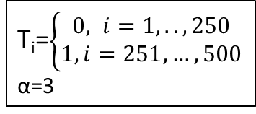
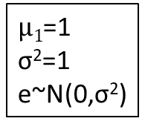

Simulation setting I
Baseline variables
Gene expression
X₁ ~ N(2,1)
X₂ ~ N(4,2)
β₁=1
β₂=1
G₁ ~ N(0,1)
G₂ ~ N(0,1)
Gene expression and outcome
are independent
No subgroups
treatment
T_{i}=$\left\{\begin{aligned}0, i=1,..,250 \\ 1, i=251,…,500\end{aligned}\right.$
α=3
$μ1$=1
σ²=1
e~N(0,σ²)
$$yi=μ+Tiα+XiTβ\text{+}\text{e}$$
outcome
Notes:
0.3 ->(0.65, 0.35) 1-> (0.88, 0.12)

Slide 12
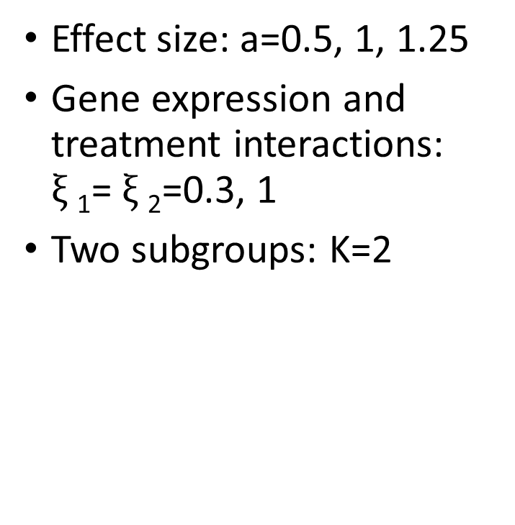
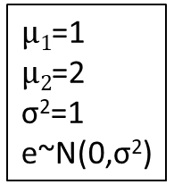

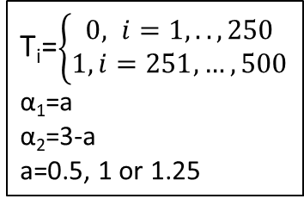
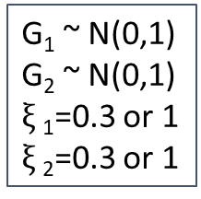
Simulation setting II
Baseline variables
Gene expression
X₁ ~ N(2,1)
X₂ ~ N(4,2)
β₁=1
β₂=1
G₁ ~ N(0,1)
G₂ ~ N(0,1)
$ξ$₁=0.3 or 1
$ξ$₂=0.3 or 1
Effect size: a=0.5, 1, 1.25
Gene expression and treatment interactions: $ξ$₁= $ξ$₂=0.3, 1
Two subgroups: K=2
treatment
T_{i}=$\left\{\begin{aligned}0, i=1,..,250 \\ 1, i=251,…,500\end{aligned}\right.$
α₁=a
α₂=3-a
a=0.5, 1 or 1.25
$μ1$=1
$μ2$=2
σ²=1
e~N(0,σ²)
$yi=μ+Tiα+XiTβ\text{+}\text{G}\text{i}\text{T}ϒ\text{+}ξ\text{1}\text{G}\text{i}\text{1}\text{T}\text{i}\text{+}ξ\text{1}\text{G}\text{i}\text{2}\text{T}\text{i}$+e
outcome
Notes:
0.3 ->(0.65, 0.35) 1-> (0.88, 0.12)

Slide 13
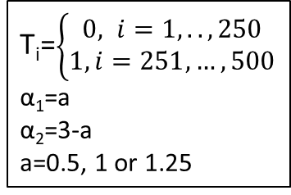
Simulation setting III
Baseline variables
Gene expression
Effect size: a=0.5, 1, 1.25
Change effect size of gene expression: ϒ1=ϒ2=0.3, 1
Two subgroups: K=2
X₁ ~ N(2,1)
X₂ ~ N(4,2)
β₁=1
β₂=1
G₁ ~ N(0,1)
G₂ ~ N(0,1)
ϒ₁=0.3 or 1
ϒ₂=0.3 or 1
treatment
T_{i}=$\left\{\begin{aligned}0, i=1,..,250 \\ 1, i=251,…,500\end{aligned}\right.$
α₁=a
α₂=3-a
a=0.5, 1 or 1.25
$$\text{π}\text{i}=\frac{exp⁡(Gi1ϒ1+Gi2ϒ2) }{1+exp⁡(Gi1ϒ1+Gi2ϒ2)}$$
Z_{i} ~ Bernoulli(π_{i})
Latent subgroup index
$μ1$=1
$μ2$=2
σ²=1
e~N(0,σ²)
$$yi=μk+Tiαk+XiTβk\text{+}\text{e}$$
outcome
Notes:
0.3 ->(0.65, 0.35) 1-> (0.88, 0.12)

Slide 14
Models
Simple linear regression model
Simple linear regression model with interactions(Check Tian Lu’s paper)
Subgroup modeling using normal mixture models.

Slide 15
Simulation result

Slide 16
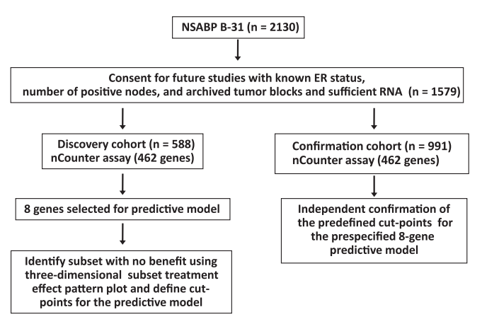
B31 trial
Goal of this study
Two treatments: ACT and ACT+Herceptin
Not all patients will benefit from adding Herceptin.
Use gene expression profiling to develop a predictive model for the degree of benefit.
Gene expression: RNA extracted from archived formalin-fixed paraffin-embedded tumor blocks
Clinical variables: Nodal status, ER status, tumor size,…
Treatment:
ACT or ACTH (ACT+Herceptin)
Outcome: disease-free survival(DFS)

Slide 17
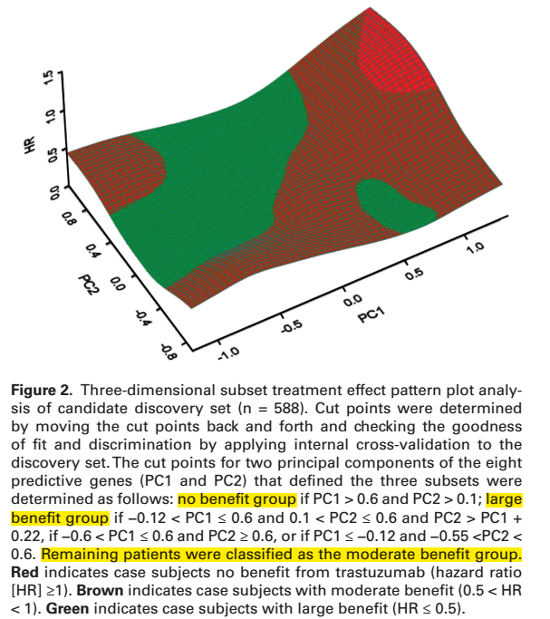
B31 trial
3 subgroups: no benefit, moderate and large benefit groups
8 genes were selected to be predictive
Reduce to PC1 and PC2 by PCA
Subgroups are defined by cutoffs of PC1 and PC2

